Slide 1

18CSO107T- IOS DEVELOPMENT Unit – 3 (Part – 1)

Slide 2
Session 1
Programmatic Views – Anchors, Margins
Programmatic Controls

Slide 3
Creating a View Programmatically
We have already created a view controller’s view programmatically by overriding the UIView Controller method loadView().
Open MapViewController.swift and override loadView() to create an instance of MKMapView and set it as the view of the view controller.
You will need a reference to the map view later on, so create a property for it as well.

Slide 4
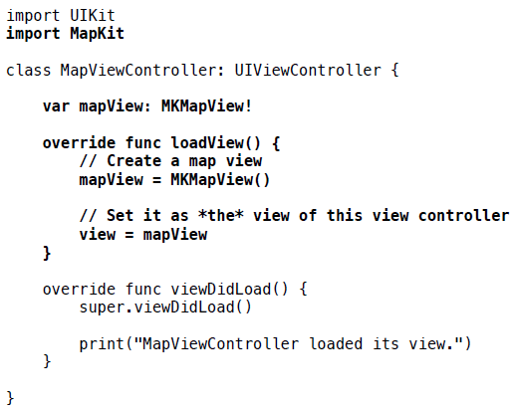
Creating a View Programmatically

Slide 5
Creating a View Programmatically
When a view controller is created, its view property is nil.
If a view controller is asked for its view and its view is nil, then the loadView() method is called.
Build and run the application. Although the application looks the same, the map view is being created programmatically instead of through Interface Builder

Slide 6
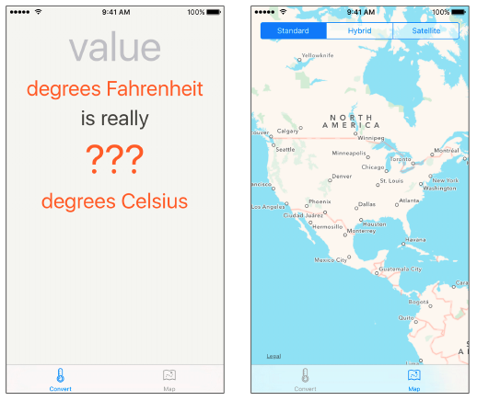
Creating a View Programmatically

Slide 7
Programmatic Constraints
If your views are created in code, then you will need to constrain them programmatically.
The interface for MapViewController is created programmatically, so it is a great candidate for programmatic constraints
To learn about programmatic constraints, you are going to add a UISegmentedControl to MapViewController’s interface.
A segmented control allows the user to choose between a discrete set of options, and you will use one to allow the user to switch between map types: standard, hybrid, and satellite.

Slide 8
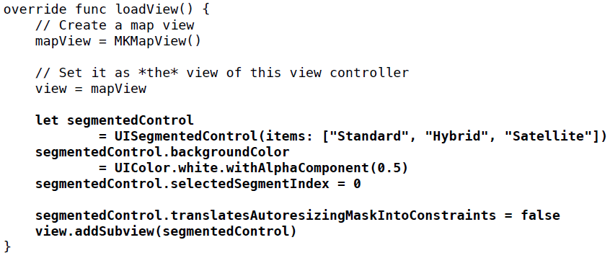
Programmatic Constraints
In MapViewController.swift, update loadView() to add a segmented control to the interface

Slide 9
Programmatic Constraints
Every view has an autoresizing mask. By default, iOS creates constraints that match the autoresizing mask and adds them to the view.
These translated constraints will often conflict with explicit constraints in the layout and cause an unsatisfiable constraints problem.
The fix is to turn off this default translation by setting the property translatesAutoresizingMaskIntoConstraints to false

Slide 10
Anchors
Auto Layout has undergone quite a lot of changes and improvements over the years, in particular with the introduction of layout anchors in iOS 9.
When building layouts using Auto Layout, we no longer manually calculate the positions and sizes of our views — and instead use a constraint-based API to have the system perform those calculations on our behalf, by evaluating the constraints we have defined.
Since this is done automatically whenever a layout condition — such as the rotation of the device — changes, supporting all the various devices iOS and macOS runs on becomes much easier

Slide 11
Anchors
Anchors are properties on the view that correspond to attributes that you might want to constrain to an anchor on another view.
For example, you might constrain the leading anchor of one view to the leading anchor of another view.
This would have the effect of the two views’ leading edges being aligned.

Slide 12
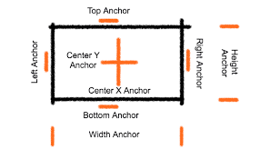
Anchors

Slide 13
Anchors
Many Anchors are available in UIView and NSView
widthAnchor.
heightAnchor.
topAnchor.
bottomAnchor.
leadingAnchor.
trailingAnchor.
leftAnchor.
rightAnchor.
These properties correspond to an NSLayoutAnchor subclass. For example, the bottomAnchor property of a view is of type NSLayoutYAxisAnchor.

Slide 14
Anchors
In the ViewController.swift file, change the viewDidLoad method as follows:
override func viewDidLoad() {
super.viewDidLoad()
// 1.
let firstButton = UIButton(type: .roundedRect)
firstButton.setTitle("First", for: .normal)
firstButton.sizeToFit()
firstButton.backgroundColor = .green
firstButton.tintColor = .black
firstButton.translatesAutoresizingMaskIntoConstraints = false
view.addSubview(firstButton)

Slide 15
Anchors
// 2.
firstButton.topAnchor.constraint(equalTo: view.topAnchor, constant: 100).isActive = true
firstButton.leadingAnchor.constraint(equalTo: view.leadingAnchor, constant: 50).isActive = true
// 3.
let secondButton = UIButton(type: .roundedRect)
secondButton.setTitle("Second", for: .normal)
secondButton.sizeToFit()
secondButton.backgroundColor = .yellow
secondButton.tintColor = .black
secondButton.translatesAutoresizingMaskIntoConstraints = false
view.addSubview(secondButton)

Slide 16
Anchors
// 4.
secondButton.centerXAnchor.constraint(equalTo: view.centerXAnchor).isActive = true
secondButton.bottomAnchor.constraint(equalTo: view.bottomAnchor, constant: -100).isActive = true
}

Slide 17
Anchors
1. an UIButton with a backgroundcolor of green and a title of “First” is added to the main view.
2. Using the top- and the leading layout anchor the button is positioned 100 point from the top and 5p points to the left of the main view
3. an UIButton with a backgroundcolor of yellow and a title of “Second” is added to the main view.
4. Using the bottom- and the centerX layout anchor the button is positioned 100 point from the bottom and at the center of the X axis of the main view.
Build and Run the Project. The 2 buttons are displayed at the correct position on the main view.

Slide 18
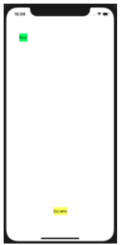
Anchors

Slide 19
Anchors
Let’s create some constraints to do the following. (Text book example)
The top anchor of the segmented control should be equal to the top anchor of its superview.
The leading anchor of the segmented control should be equal to the leading anchor of its superview.
The trailing anchor of the segmented control should be equal to the trailing anchor of its superview.

Slide 20
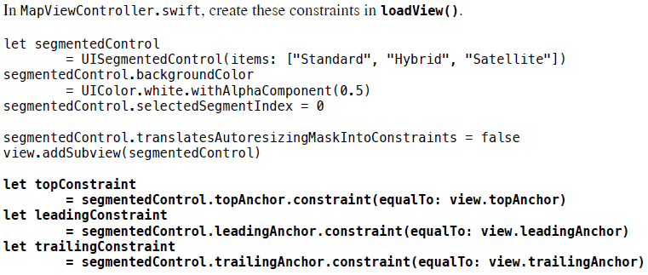
Anchors

Slide 21
Activating constraints
You now have three NSLayoutConstraint instances.
However, these constraints will have no effect on the layout until you explicitly activate them by setting their isActive properties to true.
This will resolve the Xcode’s complaint

Slide 22
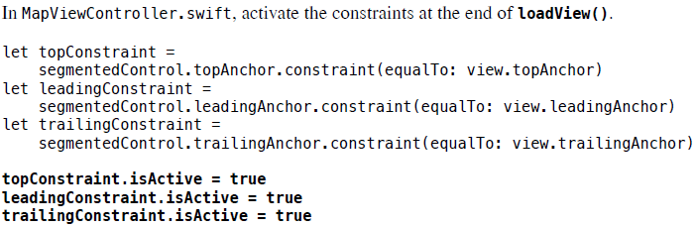
Activating constraints
Constraints need to be added to the most recent common ancestor for the views associated with the constraint

Slide 23
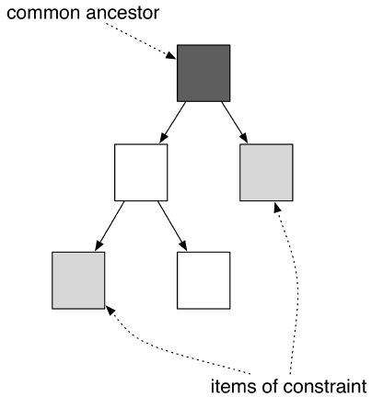
Activating constraints
A view hierarchy along with the common ancestor for two views

Slide 24
Activating constraints
If a constraint is related to just one view (such as when adding a width or height constraint to a view), then that view is considered the common ancestor.
By setting the active property on a constraint to true, the constraint will work its way up the hierarchy for the items to find the common ancestor to add the constraint to.
It will then call the method addConstraint(_:) on the appropriate view. Setting the active property is preferable to calling addConstraint(_:) or removeConstraint(_:) yourself

Slide 25
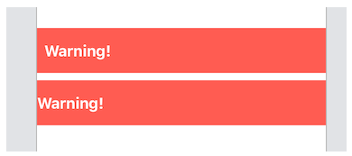
Margins
Layout margins represent the desired spacing between a view’s edges and any sub-views
Imagine a container with a label in it. You want the container to run right to the edges of its superview, but the label would look bad right up against the edge:

Slide 26
Margins
You could solve this by pinning the label a fixed distance from the edge of the container.
A better solution is to pin the label to the container’s layout margins.
Using layout margins has the following advantages:
Your intention is more obvious - a distance of 0 from a margin is more meaningful than a distance of 10 from the edge
You can take advantage of system-supplied margin sizes appropriate to the current device

Slide 27
Margins
You can amend your layout simply by adjusting the margins, instead of adjusting individual constraints
A view can infer margin information from its environment, giving you free adaptability to the iPad Mini Notch or whatever other device type arrives next.
Default margins
All views are given default layout margins by the system.
For the root view of a full-screen view controller, they vary from device to device

Slide 28
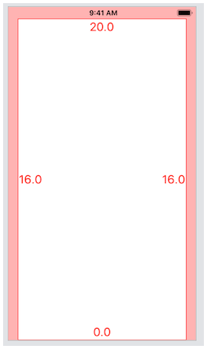
Margins
It has 20 points at the top, none at the bottom, and 16 on either edge. The side padding comes from the systemMinimumLayoutMargins property of the view controller.

Slide 29
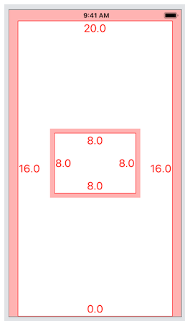
Margins
Adding a subview shows that non-root views have different defaults:

Slide 30
Margins
The sub-view has margins of 8 points on all edges.
This is the system default, and it doesn’t change between devices.
If you’re not happy with the default margins of a view, you can set them yourself, either in interface builder or in code.
Prefer to use the directionalLayoutMargins property, which takes the direction into account (leading / trailing instead of left / right).

Slide 31
Margins
You can change this at design time or while your application is running.
If you want to amend the side margins of the root view of a view controller to something smaller than the system minimums, set viewRespects SystemMinimumLayoutMargins on your view controller to false.

Slide 32
Margins
(Textbook example)
Although you could inset the segmented control using a constant on the constraint, it is much better to use the margins of the view controller’s view.
Every view has a layoutMargins property that denotes the default spacing to use when laying out content.
This property is an instance of UIEdgeInsets, which you can think of as a type of frame.
When adding constraints, you will use the layoutMarginsGuide, which exposes anchors that are tied to the edges of the layoutMargins

Slide 33
Margins
The primary advantage of using the margins is that the margins can change depending on the device type (iPad or iPhone) as well as the size of the device.
Using the margins will give you content that looks good on any device.
Update the segmented control’s leading and trailing constraints in loadView() to use the margins.

Slide 34
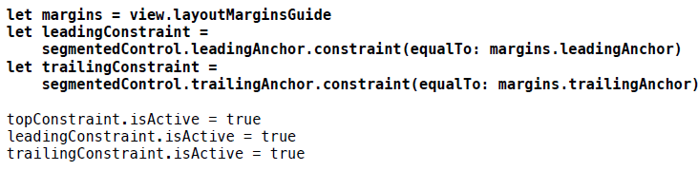
Margins
Build and run the application again. The segmented control is now inset from the view’s margins

Slide 35
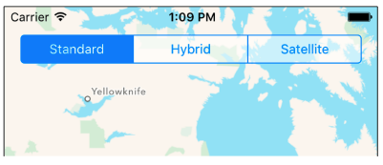
Margins

Slide 36
Programmatic Controls
Storyboard is a visual designer which is used to design User Interface for apple devices.
It has a drag and drop feature to design the User Interface.
Advantages of using Storyboard
Easy to design simple UI
Beginner friendly
Designer friendly
Faster prototyping
Auto-layout with storyboard adds pixel perfect UI desing

Slide 37
Programmatic Controls
Disadvantages of using Storyboard
It becomes slow as the project size increases
It is difficult to make changes when using a version control system
Does not provide much options to create custom views
Not suitable for complex User Interface design
We can create the view for MapViewController programmatically.
By doing so, you will learn more about view controllers and how to set up constraints and controls (such as UIButtons) programmatically

Slide 38
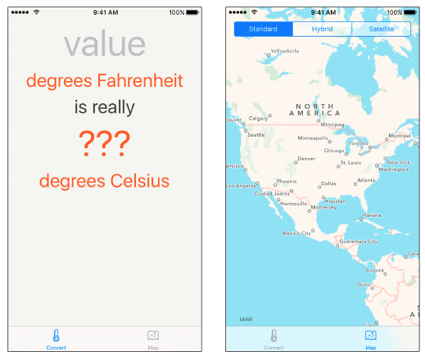
Programmatic Controls
The app ‘WorldTrotter’ with programmatic views

Slide 39
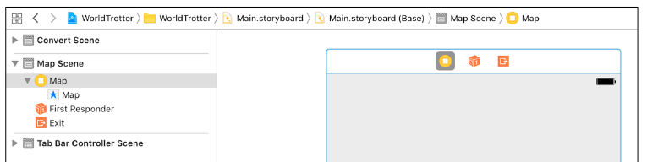
Programmatic Controls
Currently, the view for MapViewController is defined in the storyboard.
The first step, then, is to remove this view from the storyboard so you can instead create it programmatically.
In Main.storyboard, select the map view associated with Map View Controller and press Delete

Slide 40
Creating a View Programmatically
You can create a view controller’s view programmatically by overriding the UIViewController method loadView().
Open MapViewController.swift and override loadView() to create an instance of MKMapView and set it as the view of the view controller.
You will need a reference to the map view later on, so create a property for it.
When a view controller is created, its view property is nil.
If a view controller is asked for its view and its view is nil, then the loadView() method is called
Build and run the application. Although the application looks the same, the map view is being created programmatically instead of through Interface Builder

Slide 41
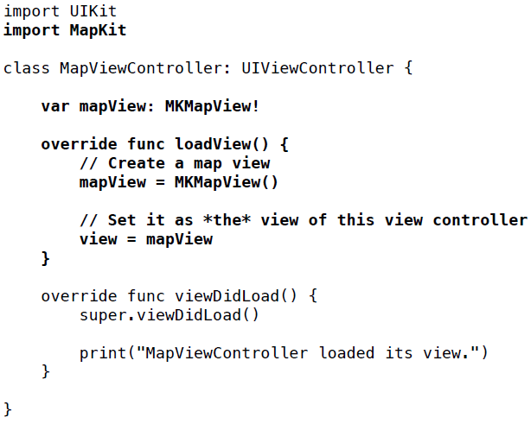
Creating a View Programmatically

Slide 42
Programmatic Constraints
How to add constraints to an interface programmatically
If your views are created in code, then you will need to constrain them programmatically.
The interface for MapViewController is created programmatically, so it is a great candidate for programmatic constraints.
You are going to add a UISegmentedControl to MapViewController’s interface
A segmented control allows the user to choose between a discrete set of options, and you will use one to allow the user to switch between map types: standard, hybrid, and satellite.

Slide 43
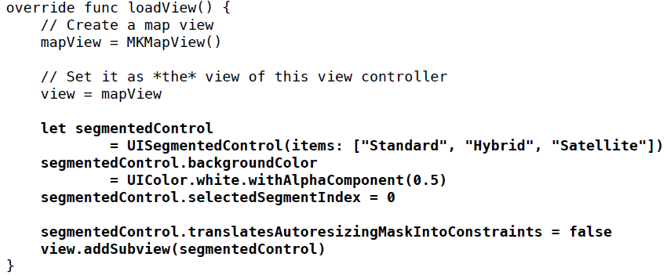
Programmatic Constraints
In MapViewController.swift, update loadView() to add a segmented control to the interface

Slide 44
Programmatic Constraints
Every view has an auto resizing mask. By default, iOS creates constraints that match the auto resizing mask and adds them to the view
These translated constraints will often conflict with explicit constraints in the layout and cause an un-satisfiable constraints problem.
The fix is to turn off this default translation by setting the property translatesAutoresizingMaskInto Constraints to false
(Before Auto Layout was introduced, iOS applications used auto-resizing masks to allow views to scale for different-sized screens at runtime)

Slide 45
Anchors
When you work with Auto Layout programmatically, you will use anchors to create your constraints.
Anchors are properties on the view that correspond to attributes that you might want to constrain to an anchor on another view.
For example, you might constrain the leading anchor of one view to the leading anchor of another view.
This would have the effect of the two views’ leading edges being aligned.

Slide 46
Anchors
Let’s create some constraints to do the following.
The top anchor of the segmented control should be equal to the top anchor of its superview.
The leading anchor of the segmented control should be equal to the leading anchor of its superview.
The trailing anchor of the segmented control should be equal to the trailing anchor of its superview.
In MapViewController.swift, create these constraints in loadView().

Slide 47
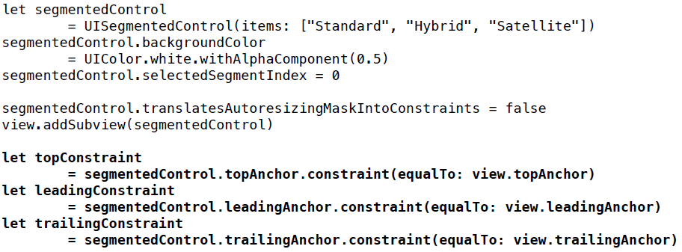
Anchors

Slide 48
Anchors
Xcode will alert you to a problem with each line you have entered. You will fix them in a moment.
Anchors have a method constraint(equalTo:) that will create a constraint between the two anchors.
There are a few other constraint creation methods on NSLayoutAnchor, including one that accepts a constant as an argument:
func constraint(equalTo anchor: NSLayoutAnchor <AnchorType>, constant c: CGFloat) -> NSLayoutConstraint

Slide 49
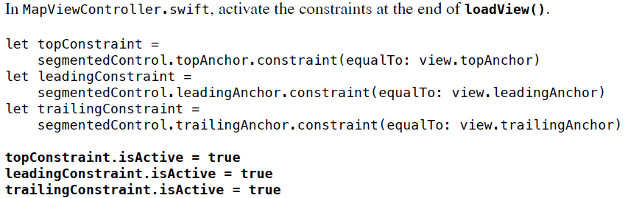
Activating constraints
You now have three NSLayoutConstraint instances. However, these constraints will have no effect on the layout until you explicitly activate them by setting their isActive properties to true. This will resolve Xcode’s complaint.

Slide 50
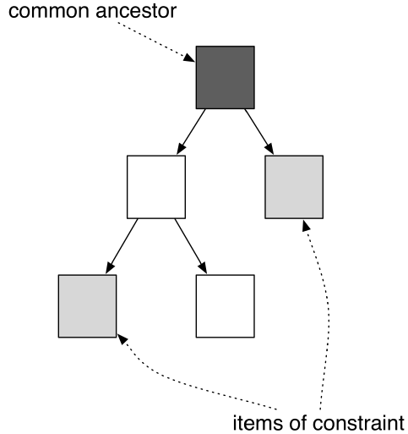
Activating constraints
Constraints need to be added to the most recent common ancestor for the views associated with the constraint.
Figure shows a view hierarchy along with the common ancestor for two views

Slide 51
Activating constraints
If a constraint is related to just one view (such as when adding a width or height constraint to a view), then that view is considered the common ancestor.
By setting the active property on a constraint to true, the constraint will work its way up the hierarchy for the items to find the common ancestor to add the constraint to.
It will then call the method addConstraint(_:) on the appropriate view.
Setting the active property is preferable to calling addConstraint(_:) or removeConstraint(_:) yourself.

Slide 52
Activating constraints
Build and run the application and switch to the MapViewController.
The segmented control is now pinned to the top, leading, and trailing edges of its superview
Build and run the application and switch to the MapViewController.
The segmented control is now pinned to the top, leading, and trailing edges of its superview

Slide 53
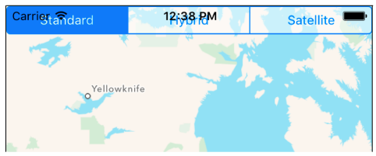
Activating constraints
End of Session 1

Slide 54
Session 2 & 3
Localization
Internationalization

Slide 55
Localization
Localization is the process of making your app support other languages.
In many cases, you make your app with English user interface first and then localize the app to other languages such as Japanese
You can ensure that your application is ready for a global audience through the processes of internationalization and localization.

Slide 56
Internationalization
Internationalization is making sure your native cultural information (like language, currency, date format, number format, etc.) is not hardcoded into your application
Localization is the process of providing the appropriate data in your application based on the user’s Language and Region Format settings. You can find these settings in the iOS Settings application
An application that takes advantage of the localization APIs does not even need to be recompiled to be distributed in other languages or regions.

Slide 57
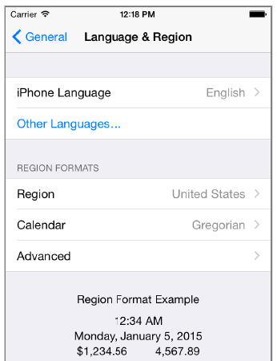
Localization
Select the General row and then the Language & Region row.

Slide 58
Formatters
Whenever you use a NumberFormatter to create a number, it checks its locale property and sets the format accordingly. So the text of the Celsius label has been internationalized from the start.
Locale knows how different regions display symbols, dates, and decimals and whether they use the metric system.
An instance of Locale represents one region’s settings for these variables.
When you access the current property on Locale, the instance of Locale that represents the user’s region setting is returned.

Slide 59
Formatters
Once you have that instance of Locale, you can ask it questions, like, “Does this region use the metric system?” or, “What is the currency symbol for this region?”
let currentLocale = Locale.current
let isMetric = currentLocale.usesMetricSystem
let currencySymbol = currentLocale.currencySymbol
Even though the Celsius label is already internationalized, there is still a problem with it.

Slide 60
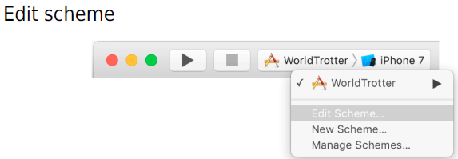
Formatters
Change the system region to Spain to see. Select the active scheme pop-up and select Edit Scheme...
Make sure that Run is selected on the left-hand side and then select the Options tab at the top.

Slide 61
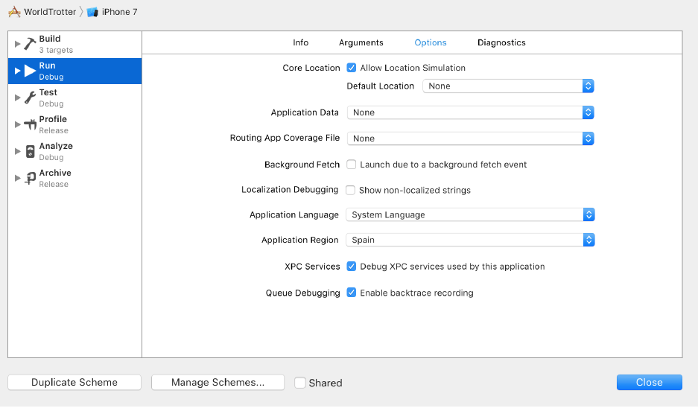
Formatters

Slide 62
Formatters
In the Application Region pop-up, select Europe and then Spain. Finally, Close the active scheme window.
Build and run the application. On the ConversionView Controller, tap the text field and make sure the software keyboard is visible.
You may already notice one difference: In Spain, the decimal separator is a comma instead of a period (and the thousands separator is a period instead of a comma), so the number written 123,456.789 in the United States would be written 123.456,789 in Spain

Slide 63
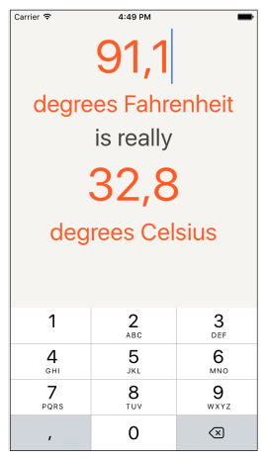
Internationalization

Slide 64
Base internationalization
Localization usually involves either generating multiple copies of resources (like images, sounds, and interface files) for different regions and languages or creating and accessing strings tables (to translate text into different languages.
Localizing a resource puts another copy of the resource in the application bundle.
These resources are organized into language-specific directories, known as lproj directories.
Each one of these directories is the name of the localization suffixed with lproj.
These language and region codes are standard on all platforms, not just iOS.

Slide 65
Base internationalization
To simplify the process of localizing interface files, Xcode has a feature called base internationalization.
Base internationalization creates the Base.lproj directory, which contains the main interface files.
One option for localizing resource files is to create separate storyboard files and manually edit each string in each file.
However, this approach does not scale well if you are planning multiple localizations.
Localizing individual interface files can then be done by creating just the Localizable.strings files

Slide 66
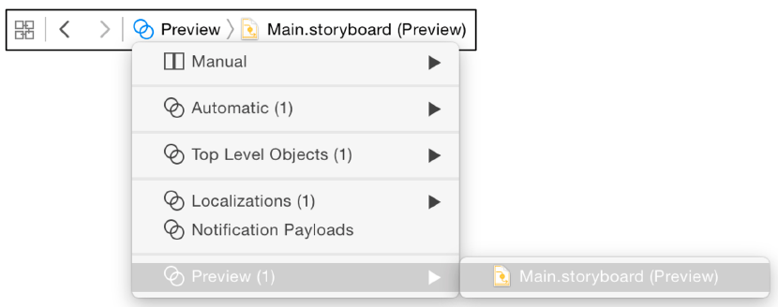
Preparing for localization
Open Main.storyboard and show the assistant editor either by clicking View → Assistant Editor → Show Assistant Editor or with the keyboard shortcut Option-Command-Return.
From the jumpbar dropdown, select Preview.
The preview assistant allows you to easily see how your interface will look across screen sizes and orientations as well as between different localized languages.

Slide 67
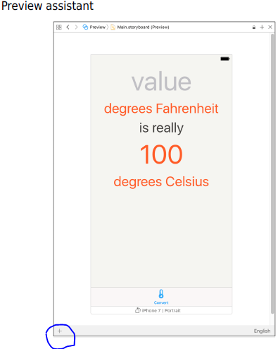
Preparing for localization
In the storyboard, select the Conversion View Controller to see its preview

Slide 68
Preparing for localization
Notice the controls in the lower corners of the preview assistant.
The + button on the left side allows you to add additional screen sizes to the preview canvas.
This allows you to easily see how changes to your interface propagate across screen sizes and orientations simultaneously.
The button on the right side allows you to select a language to preview this interface in.
You have not localized the application into another language yet, but Xcode supplies a pseudolanguage for you to use.
Pseudolanguages help you internationalize your applications before receiving translations for all of your strings and assets.

Slide 69
Localization
Now it is time to localize the app – that is, to update the strings and resources in the application for a new language.
Now, you are going to localize the interface of WorldTrotter: the Main.storyboard file.
You will create English and Spanish localizations, which will create two lproj directories in addition to the base one
Start by localizing a storyboard file. Select Main.storyboard in the project navigator.
Open the file inspector by clicking the tab in the inspector selector or by using the keyboard shortcut Option-Command-1.
Find the section in this inspector named Localization

Slide 70
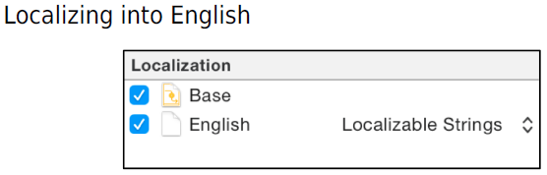
Localization
Check the English box and make sure that the dropdown says Localizable Strings.
This will create a strings table that you will use later to localize the application.
Next, in the project navigator, select the WorldTrotter project at the top.
Then select WorldTrotter under the Project section in the side list, and make sure the Info tab is open

Slide 71
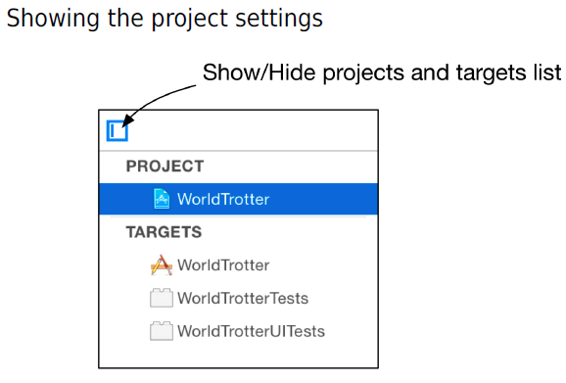
Localization

Slide 72
Localization
Click the + button under Localizations and select Spanish (es).
In the dialog, you can uncheck the LaunchScreen. storyboard file; keep the Main.storyboard file checked.
Make sure that the reference language is Base and the file type is Localizable Strings.
Click Finish. This creates an es.lproj folder and generates the Main.strings file in it that contains all the strings from the base interface file

Slide 73
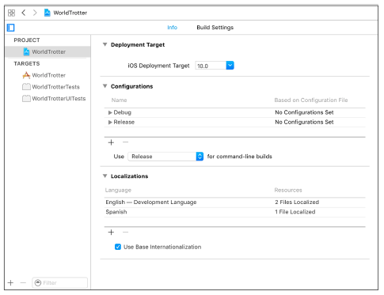
Localization

Slide 74
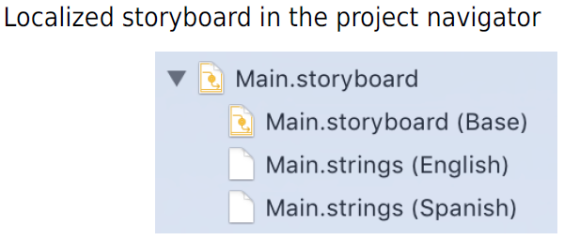
Localization
Look in the project navigator. Click the disclosure button next to Main.storyboard.
Xcode moved the Main.storyboard file to the Base.lproj directory and created the Main.strings file in the es.lproj directory

Slide 75
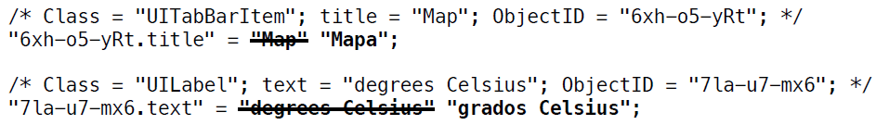
Localization
Click on the Spanish version of Main.strings. When this file opens, the text is not in Spanish. You have to translate localized files yourself;
Edit this file according to the following text. The numbers and order may be different in your file, but you can use the text and title fields in the comments to match up the translations

Slide 76
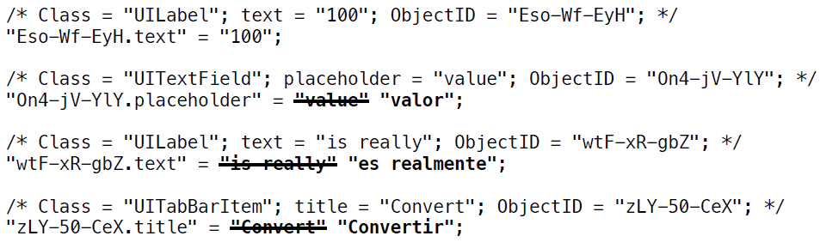
Localization

Slide 77
Localization
Open the active scheme pop-up and select Edit Scheme.
Make sure Run is selected on the lefthand side and open the Options tab. Open the Application Language pop-up and select Spanish.
Finally, confirm that Spain is still selected from the Application Region pop-up. Close the window
Build and run the application. Make sure you are viewing the ConversionViewController, and you will see the interface in Spanish.
Because you set the constraints on the labels to accommodate different lengths of text, they resize themselves appropriately

Slide 78
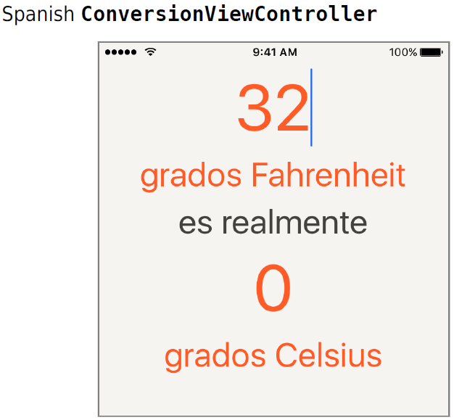
Localization

Slide 79
End of Part 1 – Unit 3

